Slide 1
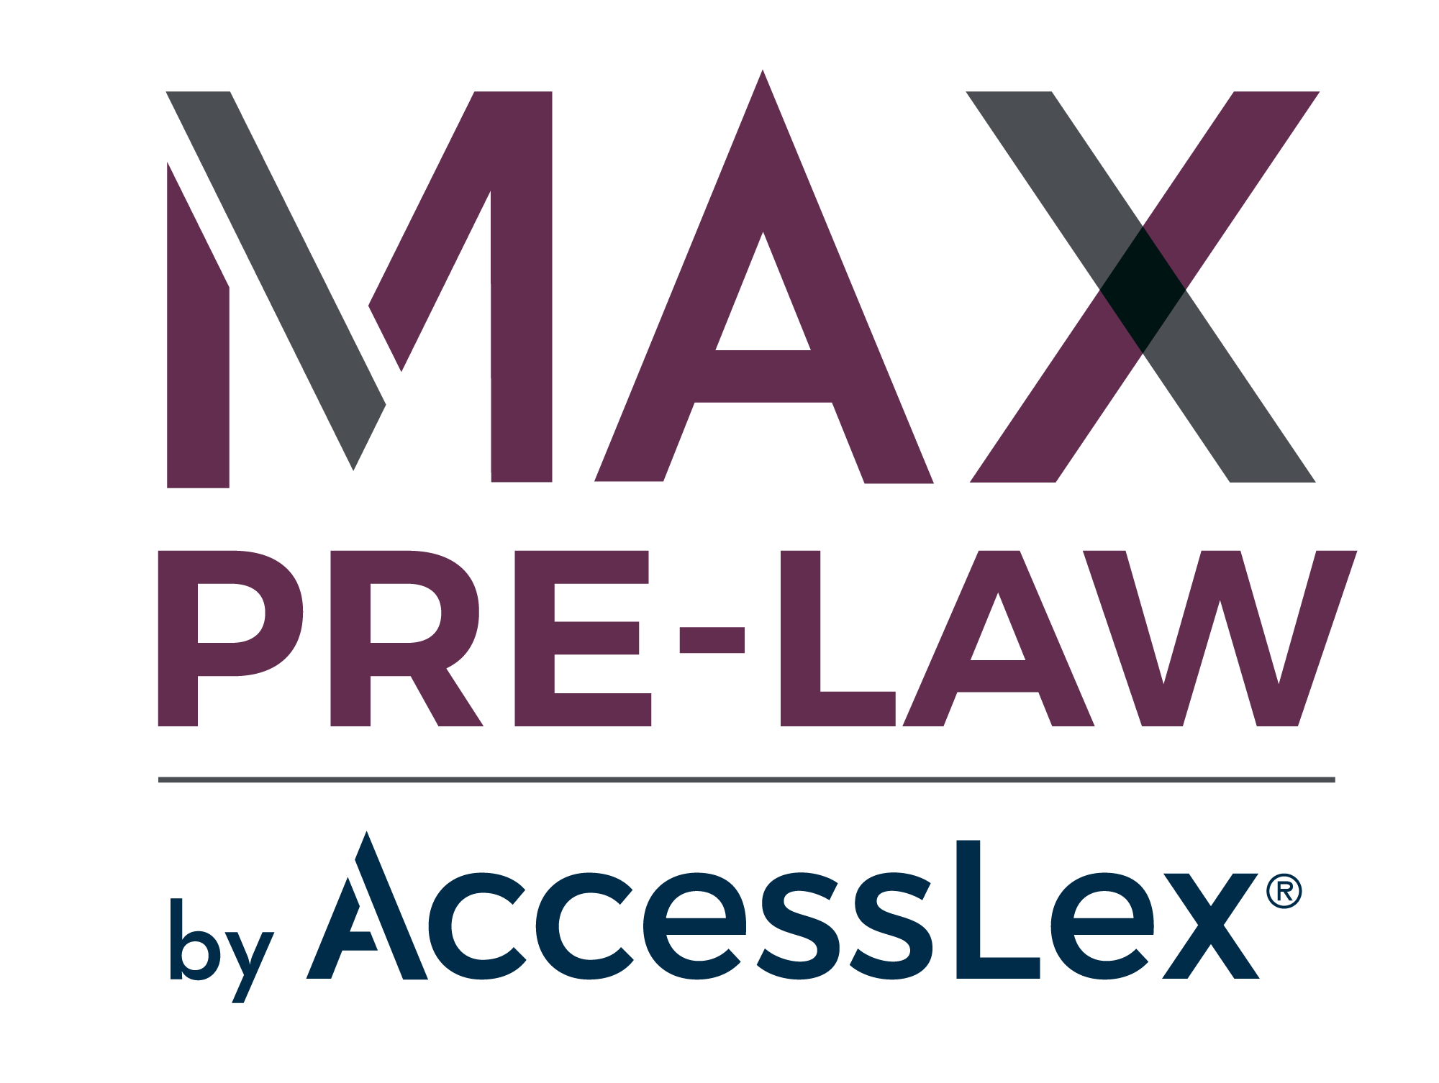
Introducing
Our New Online Resource Suite!
Notes:
MAX Pre-Law by AccessLex is a new online suite of resources created exclusively for aspiring law students. Designed by a team of JDs, financial aid experts, law school admissions professionals and experienced pre-law advisors, it offers financial aid and admissions information, strategy and tools. And it is FREE to you from AccessLex Institute, the largest nonprofit organization dedicated to legal education.

Slide 2
Introducing
Our New Online Resource Suite!
Notes:
MAX Pre-Law by AccessLex is a new online suite of resources created exclusively for aspiring law students. Designed by a team of JDs, financial aid experts, law school admissions professionals and experienced pre-law advisors, it offers financial aid and admissions information, strategy and tools. And it is FREE to you from AccessLex Institute, the largest nonprofit organization dedicated to legal education.

Slide 3
MAX PRE-LAW OFFERINGS:
Four interactive lessons:
1.
YOUR LAW SCHOOL INVESTMENT
2.
UNDERSTANDING LAW SCHOOL ADMISSIONS AND FINANCIAL AID
3.
GETTING INTO LAW SCHOOL
4.
PAYING FOR LAW SCHOOL
Notes:
MAX Pre-Law content is based on the questions and concerns we hear every day from pre-law advisors, prospective applicants, current law students and law school professionals. With that as our foundation, we believe MAX Pre-Law can help applicants make confident decisions and be financially prepared for the path ahead. In addition to the four interactive lessons, MAX Pre-Law includes carefully developed worksheets, guides and resources on topics like choosing a law school, applying to law school, paying for law school and working as a lawyer. Live coaching, webinars and other non-profit information sources are also available.

Slide 4
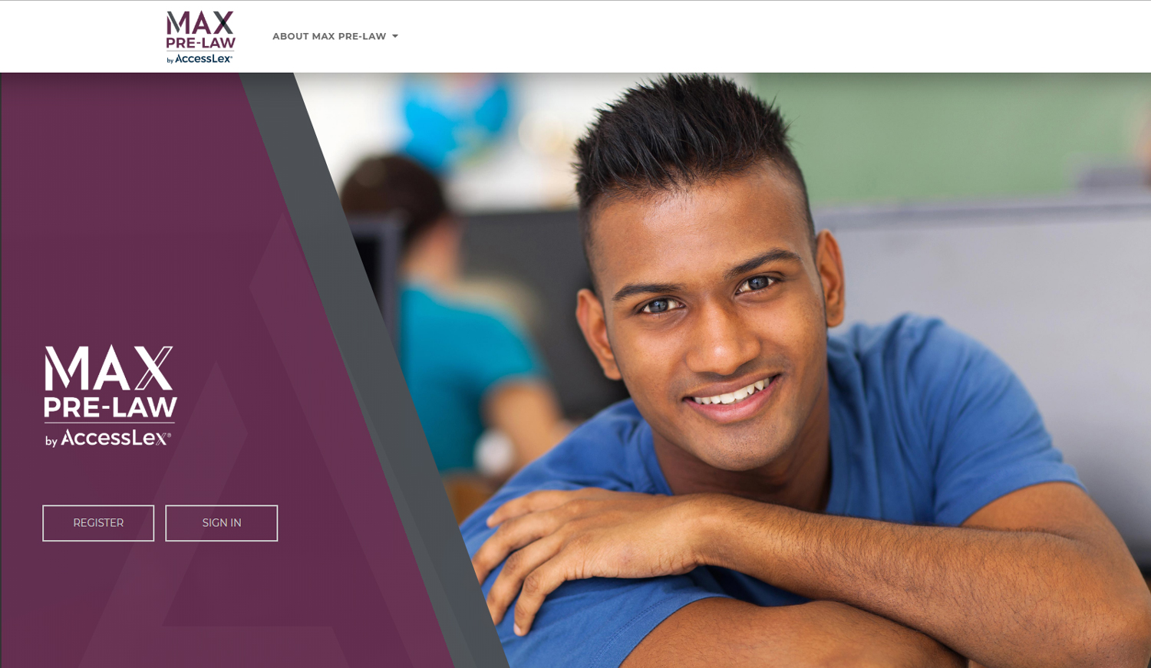
REGISTER AT AccessLex.org/MAX-prelaw
Notes:
MAX Pre-Law is a simple profile environment that allows you to track your progress while keeping profile time and personal details to a minimum—all you need to register is your name, email address, school and class year! MAX Pre-Law is fully mobile and built with smart-phone and laptop/tablet functionality.

